Slide 1
25 – Clean Code – Design Patterns
Based on the CleanCoders videos by Uncle Bob Martin
Rupert Waldron

Slide 2
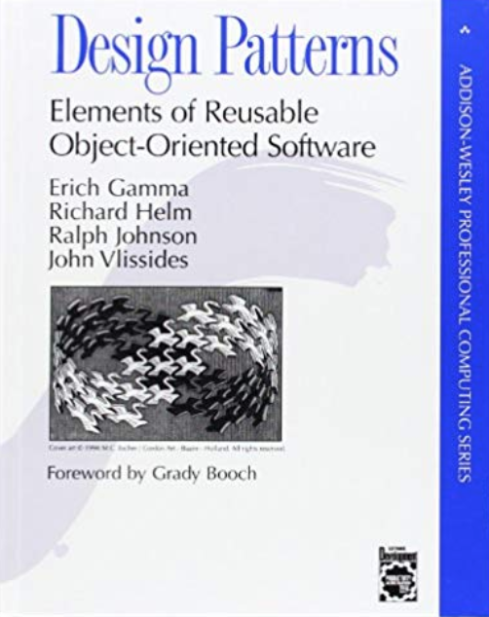
So What is a design pattern?
A design pattern is a named solution to a problem in a context
Naming the pattern helps developers discuss solutions to a design problem
Types of Patterns:
Creational Patterns – help create instances of objects
Structural Patterns – help set up the communication pathways between separate groups of objects
Behavioural Patterns – help you partition the behaviours of your system into discrete patterns.
GOF Book

Slide 3
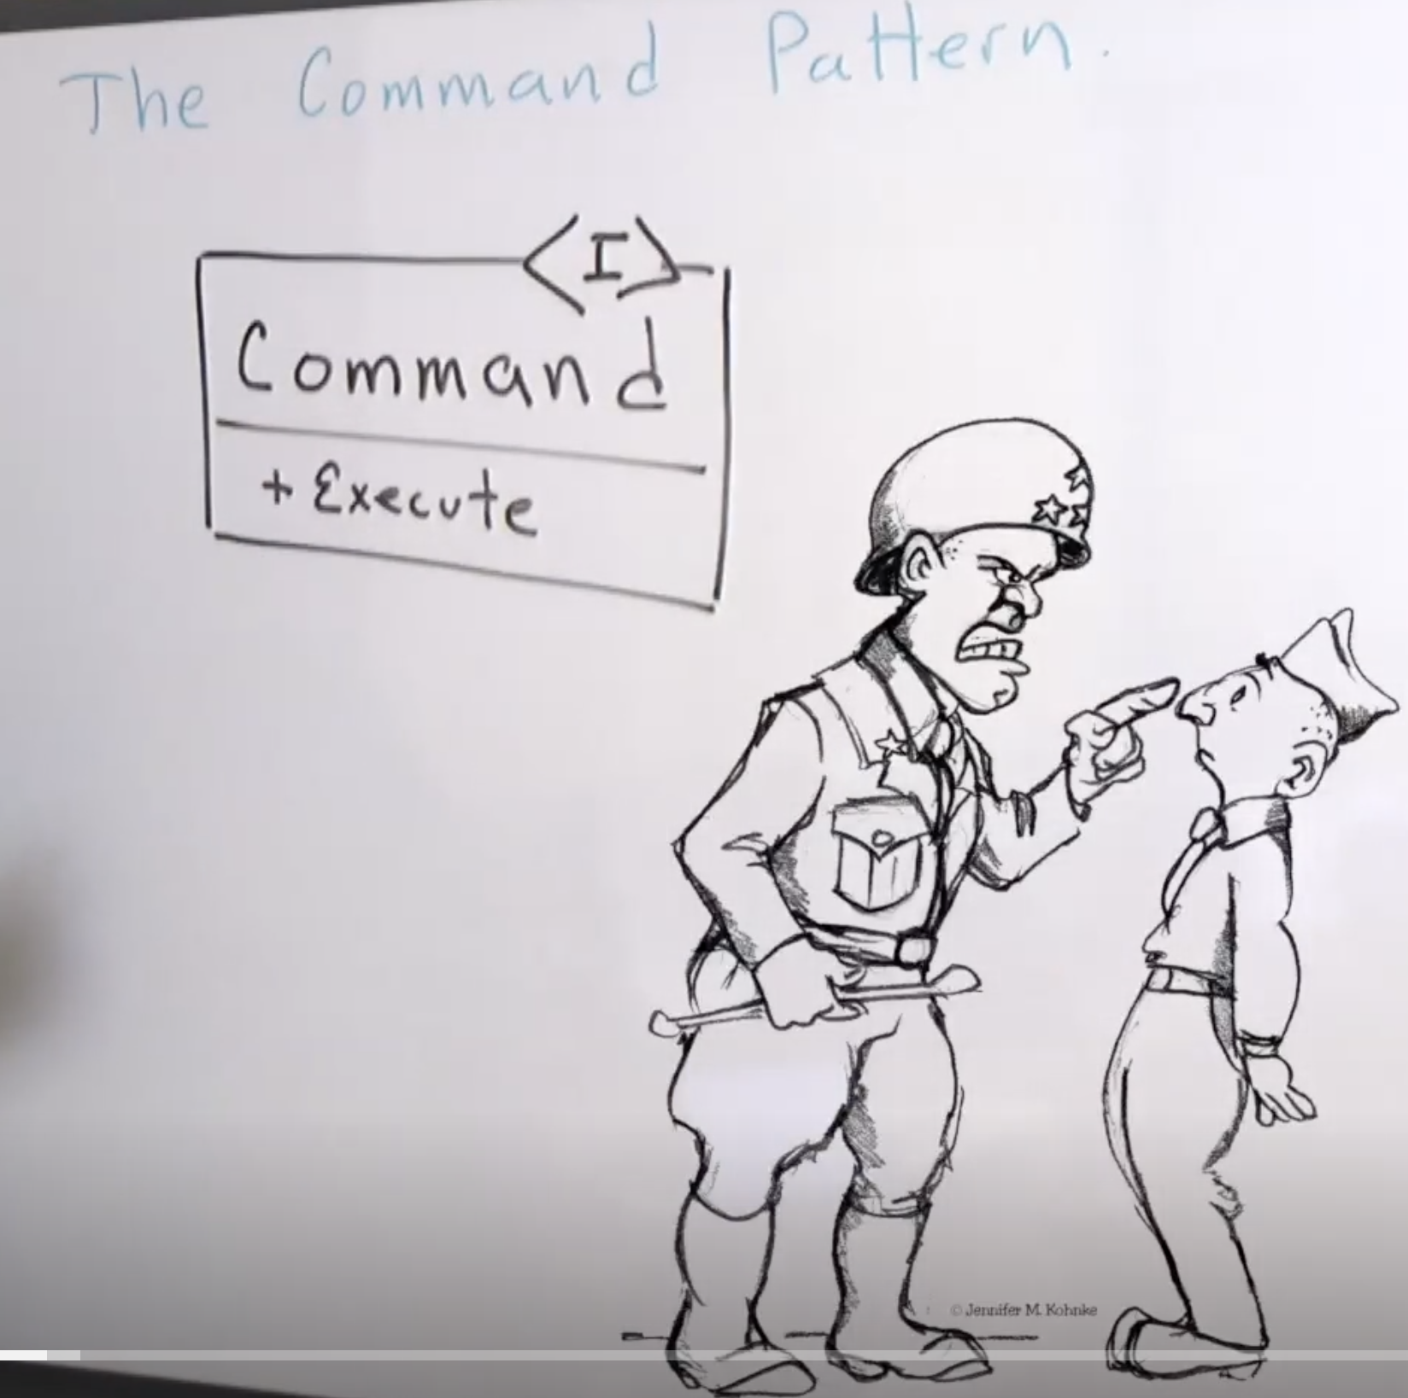
The Command Pattern
The command pattern is a way of coupling what is done from who does it.
It can decouple what gets done from who does it – special decoupling. And also you can store commands objects in an array and execute them at a specific time – temporal decoupling.
Code : turn lights on and off

Slide 4
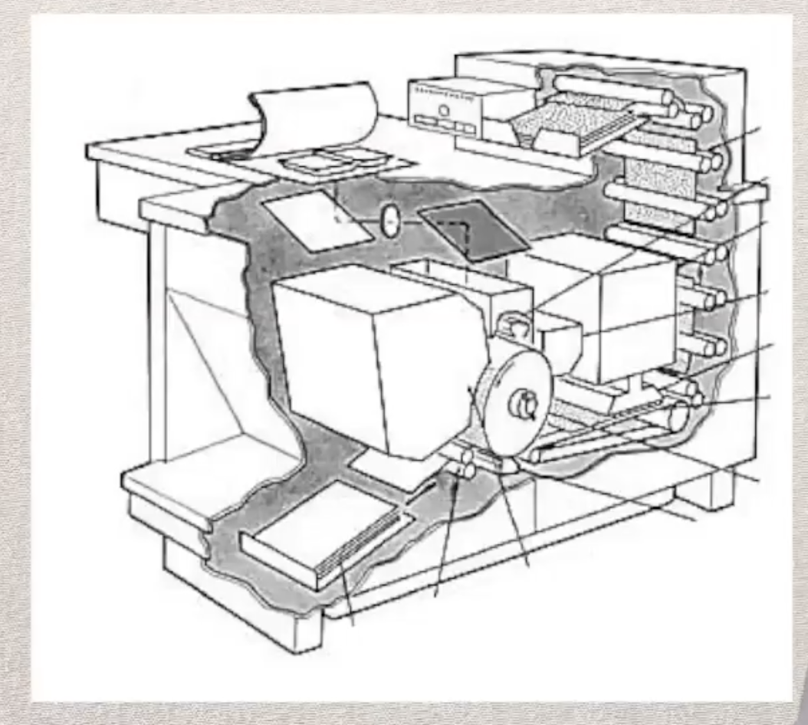
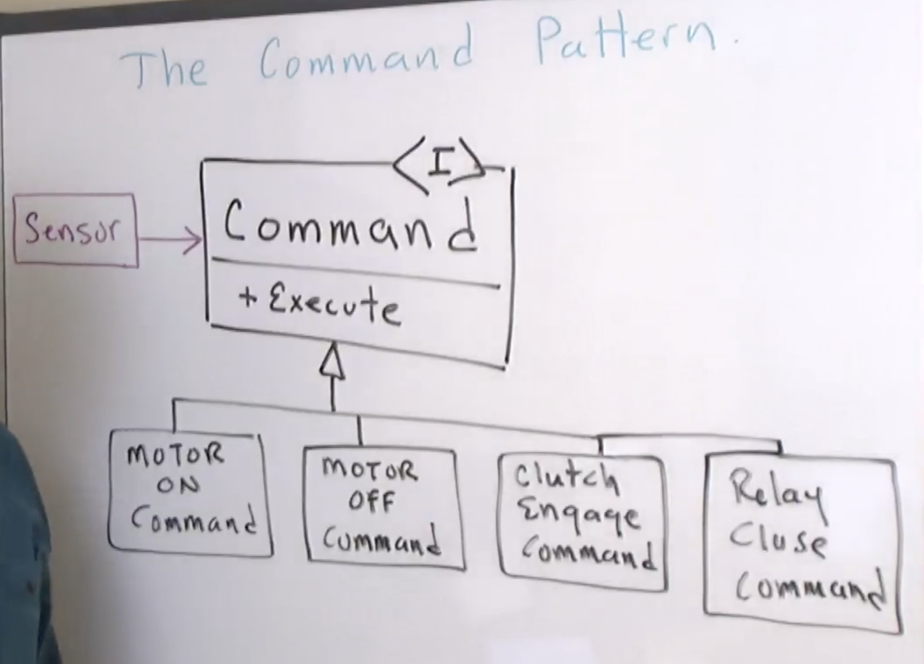
Xerox colour copier example – special decoupling
Lots of motors to control
Every time the sensor is tripped the exectute() method on the command object is called
Sensor contains a command object
The sensor knows nothing about the type of device it is controlling
The Command Pattern is a great way of de-coupling what is done from who does it
Code : process requests

Slide 5
You can even implement Undo!
Sensor contains a command object
Every time the sensor is tripped the exectute() method on the command object is called
The sensor knows nothing about the type of device it is controlling
The Command Pattern is a great way of de-coupling what is done from who does it
Code : process requests

